Slide 1
Dimensionality Reduction Techniques
By
Dr. S PADMANABHAN

Slide 2
What is Dimensionality Reduction?
The number of input features, variables, or columns present in a given dataset is known as dimensionality, and the process to reduce these features is called dimensionality reduction.
A dataset contains a huge number of input features in various cases, which makes the predictive modeling task more complicated. Because it is very difficult to visualize or make predictions for the training dataset with a high number of features, for such cases, dimensionality reduction techniques are required to use.

Slide 3
What is Dimensionality Reduction?
Dimensionality reduction technique can be defined as, "It is a way of converting the higher dimensions dataset into lesser dimensions dataset ensuring that it provides similar information." These techniques are widely used in machine learning for obtaining a better fit predictive model while solving the classification and regression problems.
It is commonly used in the fields that deal with high-dimensional data, such as speech recognition, signal processing, bioinformatics, etc. It can also be used for data visualization, noise reduction, cluster analysis, etc.

Slide 4
The Curse of Dimensionality
Handling the high-dimensional data is very difficult in practice, commonly known as the curse of dimensionality. If the dimensionality of the input dataset increases, any machine learning algorithm and model becomes more complex. As the number of features increases, the number of samples also gets increased proportionally, and the chance of overfitting also increases. If the machine learning model is trained on high-dimensional data, it becomes overfitted and results in poor performance.
Hence, it is often required to reduce the number of features, which can be done with dimensionality reduction.

Slide 5
Benefits of applying Dimensionality Reduction
Some benefits of applying dimensionality reduction technique to the given dataset are given below:
By reducing the dimensions of the features, the space required to store the dataset also gets reduced.
Less Computation training time is required for reduced dimensions of features.
Reduced dimensions of features of the dataset help in visualizing the data quickly.
It removes the redundant features (if present) by taking care of multicollinearity.

Slide 6
Disadvantages of dimensionality Reduction
There are also some disadvantages of applying the dimensionality reduction, which are given below:
Some data may be lost due to dimensionality reduction.
In the PCA dimensionality reduction technique, sometimes the principal components required to consider are unknown.

Slide 7
Approaches of Dimension Reduction
There are two ways to apply the dimension reduction technique, which are given below:
Feature Selection
Feature selection is the process of selecting the subset of the relevant features and leaving out the irrelevant features present in a dataset to build a model of high accuracy. In other words, it is a way of selecting the optimal features from the input dataset.

Slide 8
Feature Extraction:
Feature extraction is the process of transforming the space containing many dimensions into space with fewer dimensions. This approach is useful when we want to keep the whole information but use fewer resources while processing the information.
Some common feature extraction techniques are:
Principal Component Analysis
Linear Discriminant Analysis
Kernel PCA
Quadratic Discriminant Analysis

Slide 9
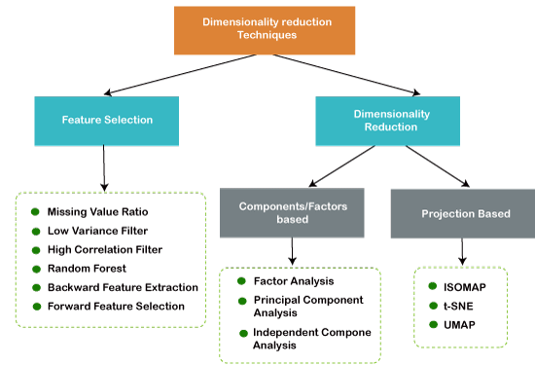

Slide 10
Principal Component Analysis (PCA)
Principal Component Analysis (PCA) is one of the dimensionality reduction techniques that is used to reduce the dimensions of the large datasets.
It transforms the large set of features into a small set such that it will contain the maximum information as in the original data.
The number of components is less than or equal to the number of independent variables.
PCA projects the original dataset on the lower dimensional plane.
It transoms the original data to a new set of uncorrelated variables.

Slide 11
Principal Component Analysis (PCA)
Principal Component Analysis (PCA) is a technique for dimensionality reduction that identifies a set of orthogonal axes, called principal components, that capture the maximum variance in the data.
It is used to remove the redundancy in the data.
The principal components are linear combinations of the original variables in the dataset and are ordered in decreasing order of importance.
The total variance captured by all the principal components is equal to the total variance in the original dataset.
Principal components are always orthogonal to each other.

Slide 12
Principal Component Analysis (PCA)
The total variance captured by all the principal components is equal to the total variance in the original dataset.
The principal components are linear combinations of the original variables in the dataset and are ordered in decreasing order of importance.
The first principal component captures the most variation in the data, but the second principal component captures the maximum variance that is orthogonal to the first principal component, and so on.

Slide 13
Principal Component Analysis (PCA)
Principal Component Analysis is a statistical process that converts the observations of correlated features into a set of linearly uncorrelated features with the help of orthogonal transformation. These new transformed features are called the Principal Components. It is one of the popular tools that is used for exploratory data analysis and predictive modeling.
PCA works by considering the variance of each attribute because the high attribute shows the good split between the classes, and hence it reduces the dimensionality.
Some real-world applications of PCA are image processing, movie recommendation system, optimizing the power allocation in various communication channels.

Slide 14
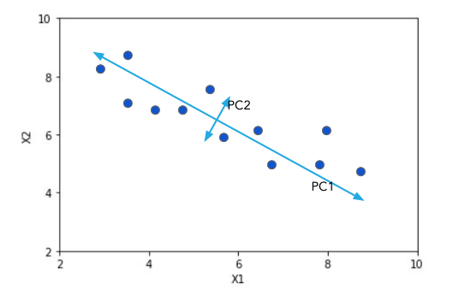
Principal Component Analysis (PCA)

Slide 15
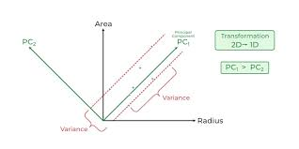
Principal Component Analysis (PCA)

Slide 16
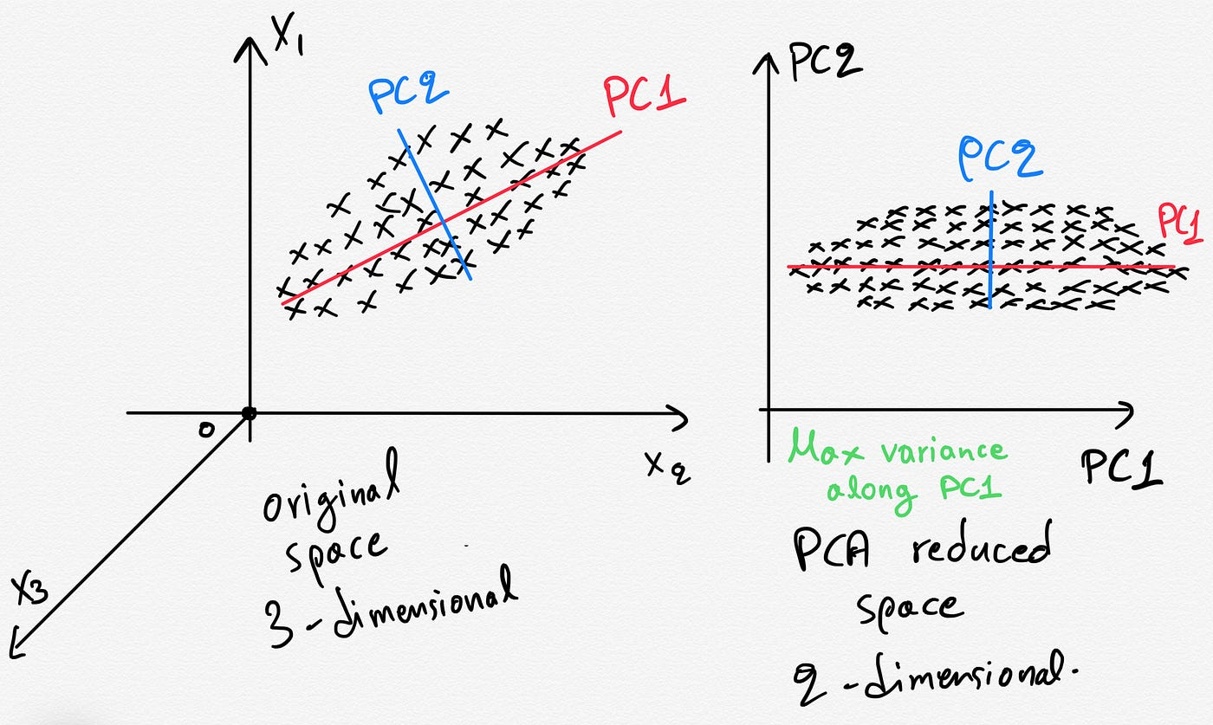
Principal Component Analysis (PCA)

Slide 17
PCA - procedure
Step-1: Standardize the data
Step-2: Compute the covariance matrix
Step-3: Calculate the Eigenvalues and Eigenvectors
Step-4: Sort the eigenvalues in the descending order
Step-5: Select the eigenvectors that explains the maximum variance in the data

Slide 18
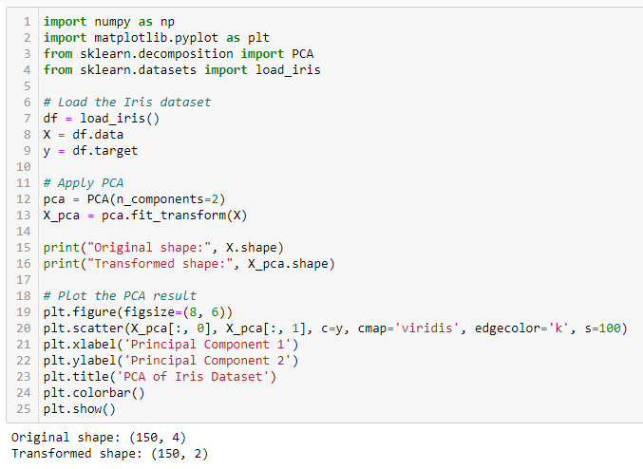
Python Code

Slide 19
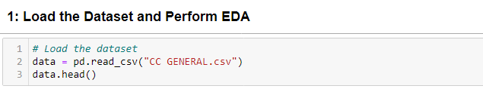


Perform EDA and pre-processing techniques required for PCA and Clustering. Print the top 5 Eigenvalues and Eigenvectors.

Slide 20
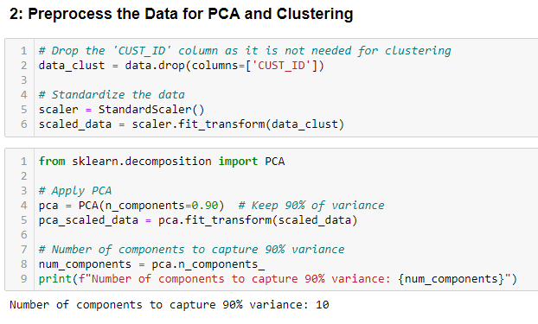
Perform EDA and pre-processing techniques required for PCA and Clustering. Print the top 5 Eigenvalues and Eigenvectors.

Slide 21
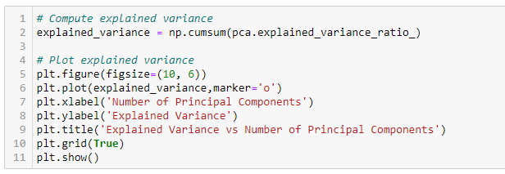
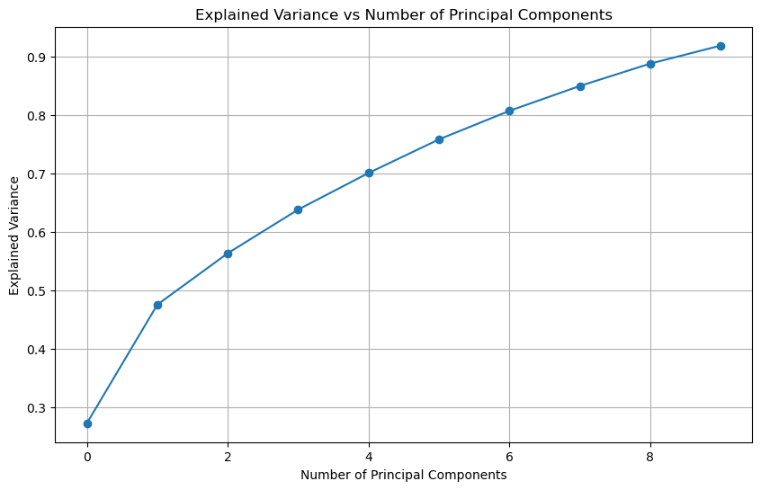

Slide 22
